Slide 1

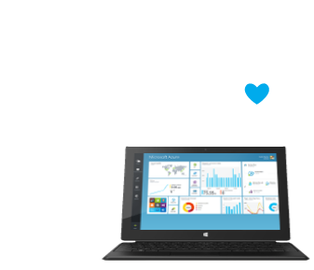
Introduction to Azure
Microsoft's application platform for the public cloud
Web Services and Cloud
Telerik Software Academy
http://academy.telerik.com

Slide 2
Table of Contents
What is Microsoft Azure?
The Components of Azure
Management Portal
Compute
Data Management
Networking
Developer Services
Identity and Access

Slide 3
Table of Contents (2)
Mobile
Back-up
Messaging and Integration
Compute Assistance
Performance
Big Data and Big Compute
Media

Slide 4
Questions?
Introduction to Azure

Slide 5




Free Trainings @ Telerik Academy
C# Programming @ Telerik Academy
csharpfundamentals.telerik.com
Telerik Software Academy
academy.telerik.com
Telerik Academy @ Facebook
facebook.com/TelerikAcademy
Telerik Software Academy Forums
forums.academy.telerik.com

